Slide 1

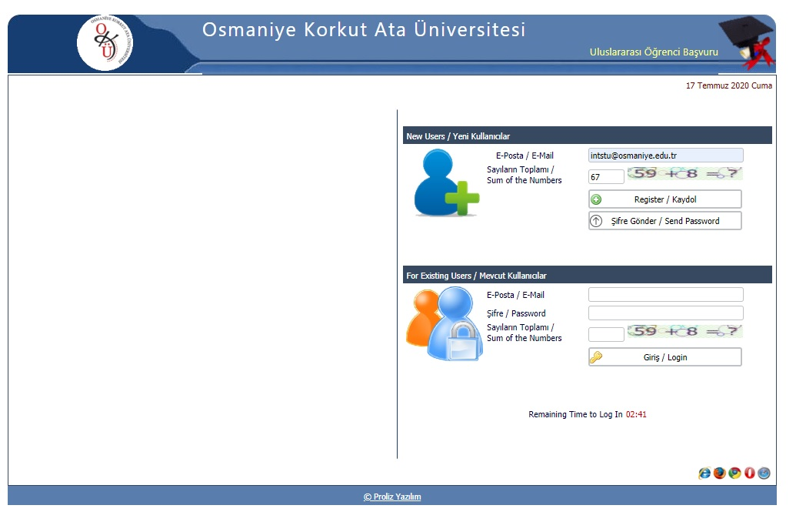
OKÜ INTERNATIONAL STUDENT APPLICATION
Candidates need to register to the portal first with their e-mail addresses that they use actively.

Slide 2
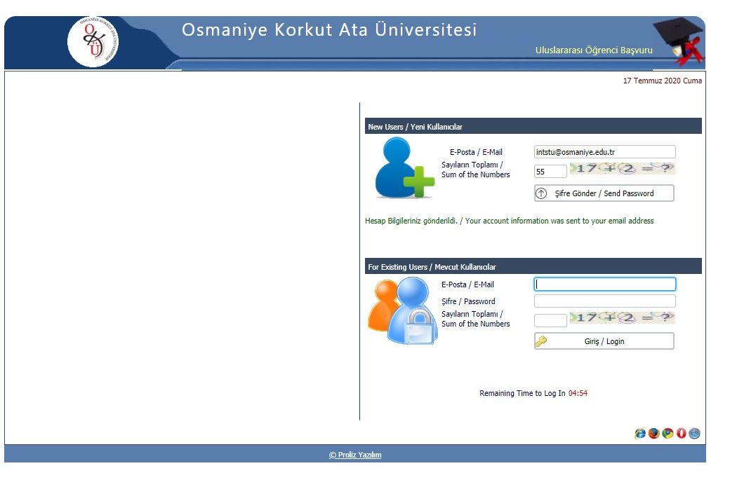
OKÜ ULUSLARARASI ÖĞRENCİ BAŞVURUSU
You will receive a notification stating that the relevant information concerning your account has been sent to your e-mail address.

Slide 3
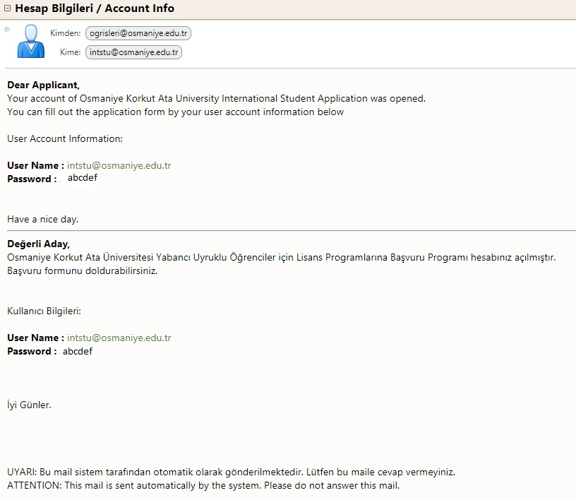
OKÜ ULUSLARARASI ÖĞRENCİ BAŞVURUSU
The password that you will use on each further occasion after this stage will be sent to your e-mail address.
Please make sure that the e-mail address you enter is one that you check often. From now onwards, you will be contacted by this e-mail address only.

Slide 4
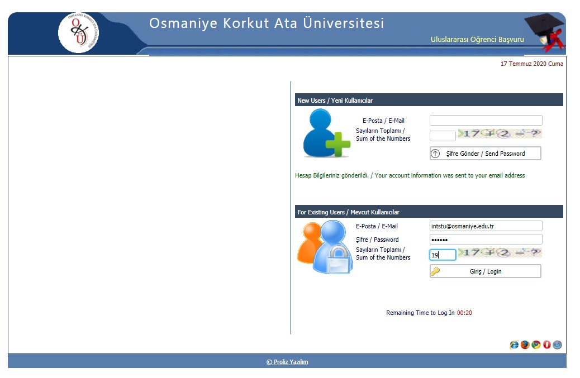
OKÜ ULUSLARARASI ÖĞRENCİ BAŞVURUSU
You can login to the system using the password that has been sent to your e-mail address, as shown on the screenshot nearby.

Slide 5
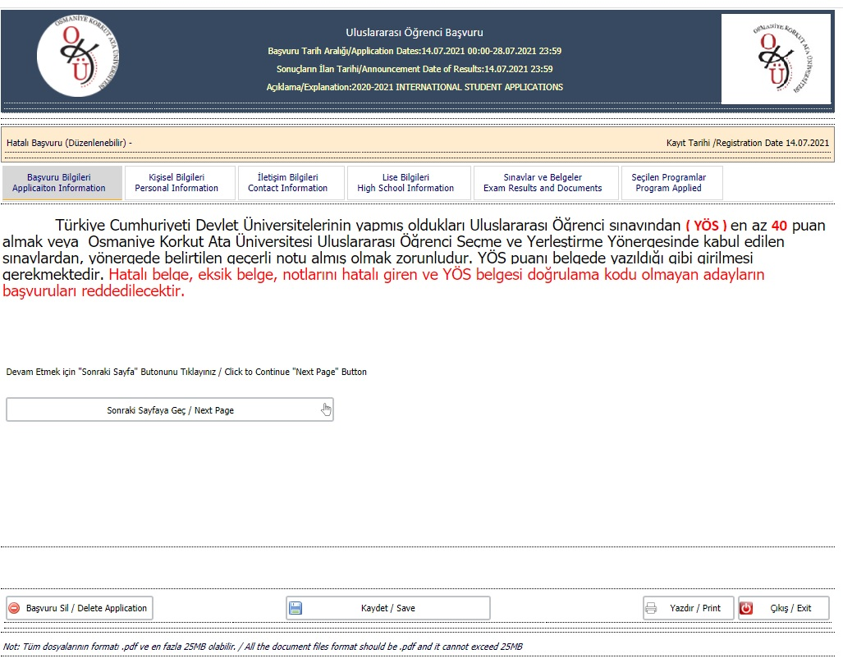
OKÜ ULUSLARARASI ÖĞRENCİ BAŞVURUSU
You will see the screen nearby. Please read carefully the section named «Application Information».
Advance to the next page using the button «next page»

Slide 6
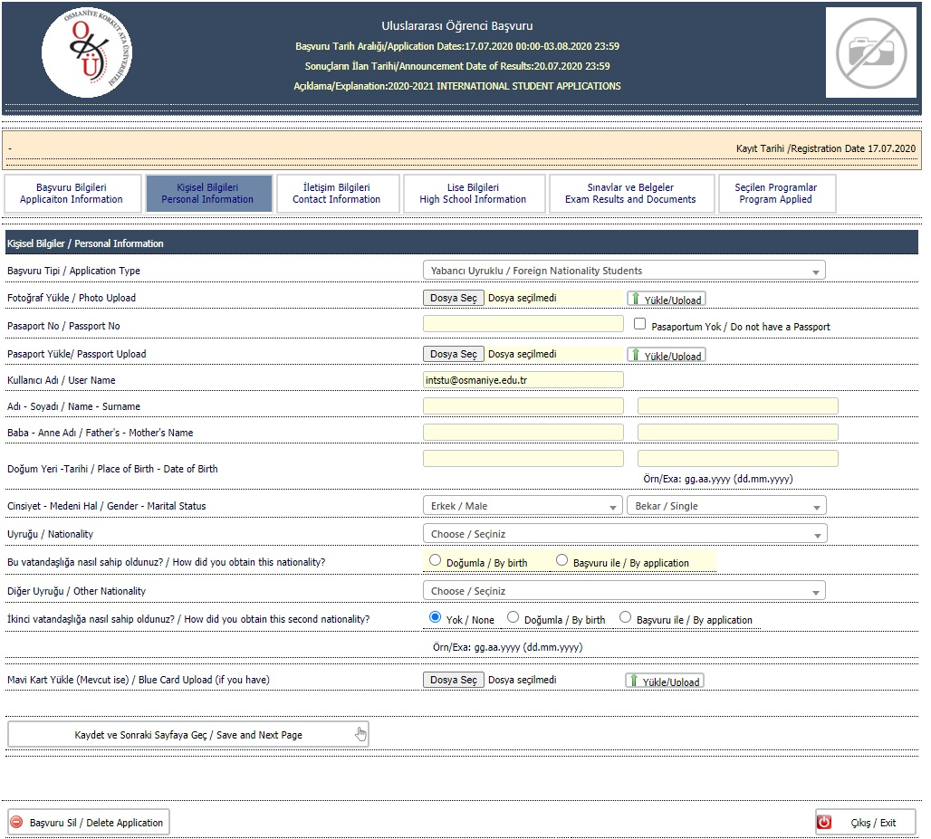
OKÜ ULUSLARARASI ÖĞRENCİ BAŞVURUSU
You will see the screen nearby first. In the section «Personal Information» you need to enter personal information.

Slide 7
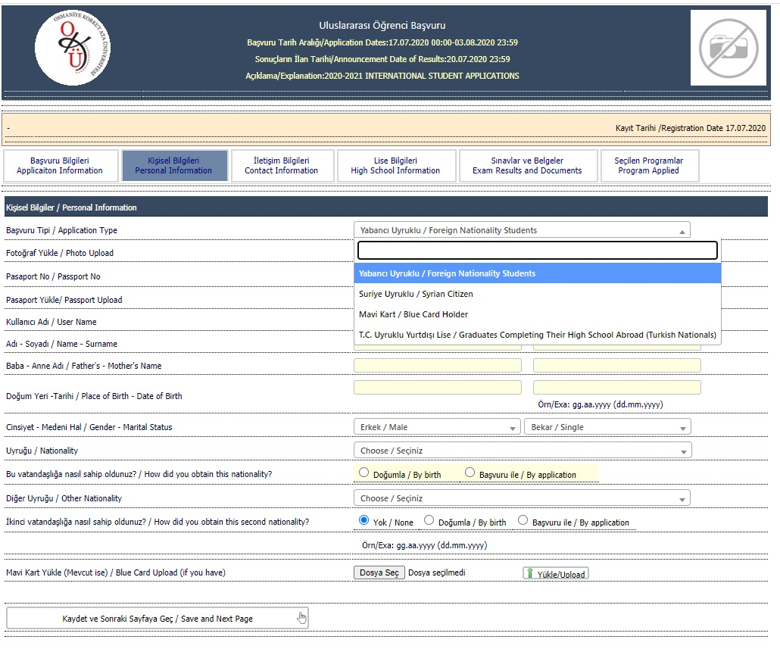
OKÜ ULUSLARARASI ÖĞRENCİ BAŞVURUSU
Candidates need to select the application type first, as indicated on the screen on the left, and then enter the other required information.

Slide 8
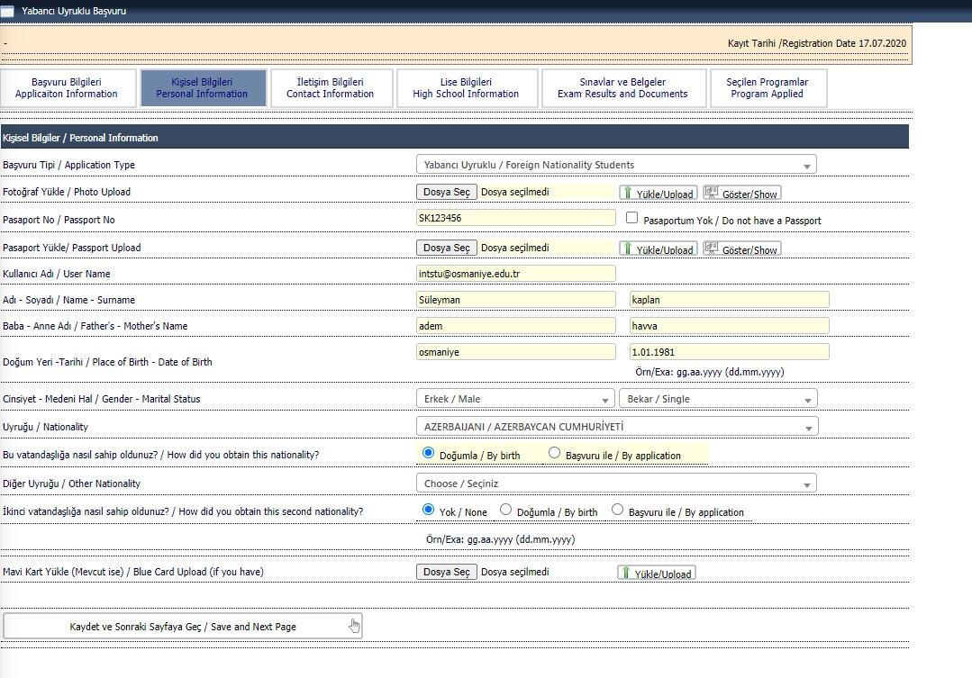
OKÜ ULUSLARARASI ÖĞRENCİ BAŞVURUSU
Once the application type is selected, candidates need to upload a recent photo.
Candidates need to upload the relevant pages of their passports. Candidates of Syrian descent who do not hold a valid passport will upload their transitory identity card.
All the required areas must be filled in.
Candidates who hold dual citizenship and those who hold Turkish blue card (Mavi Kart) need to fill in the required areas indicated on the left
Click the button «Save and Next Page» to save and proceed to the following page

Slide 9
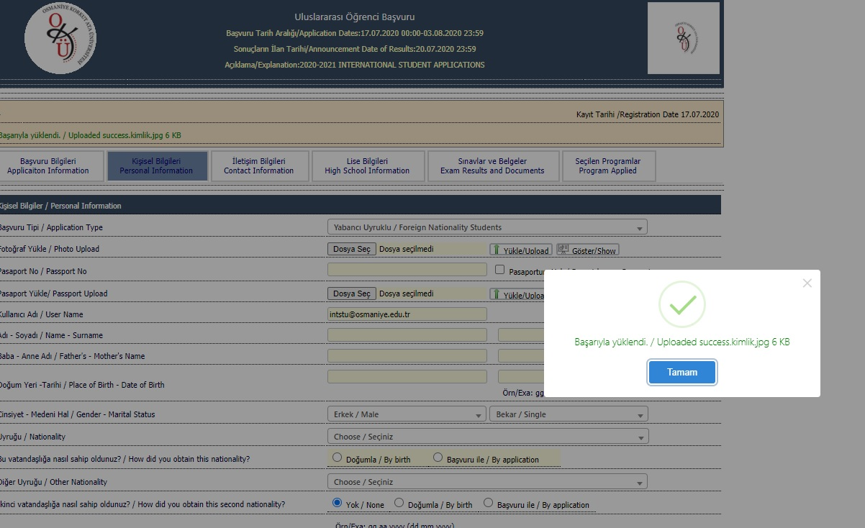
OKÜ ULUSLARARASI ÖĞRENCİ BAŞVURUSU
You can advance to the following page once you get a notification from the system stating that you have successfully uploaded the required information.

Slide 10
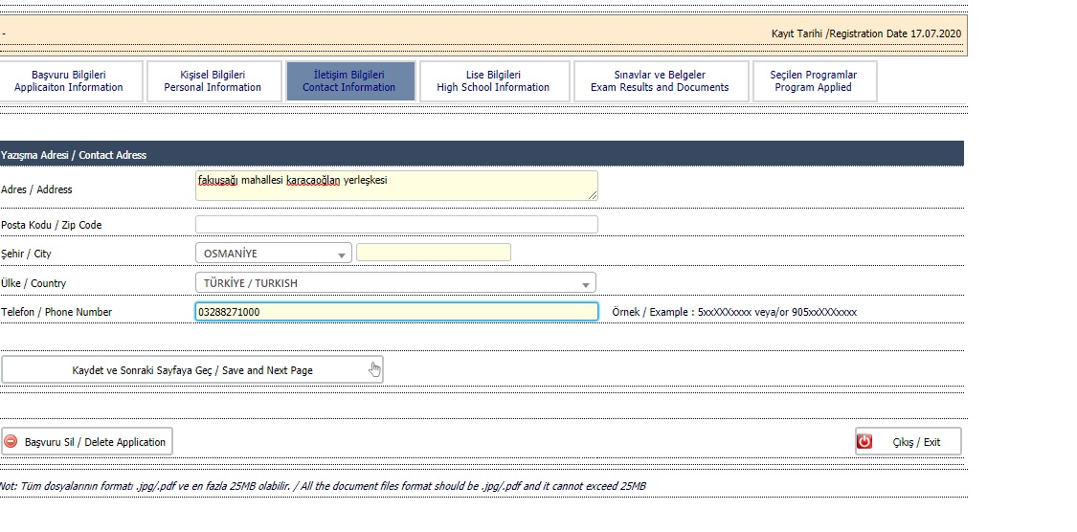
OKÜ ULUSLARARASI ÖĞRENCİ BAŞVURUSU
Candidates need to fill in the required areas concerning their contact details
Once you complete filling in all the required areas you can go to the following page using the button « Save and Next Page»

Slide 11
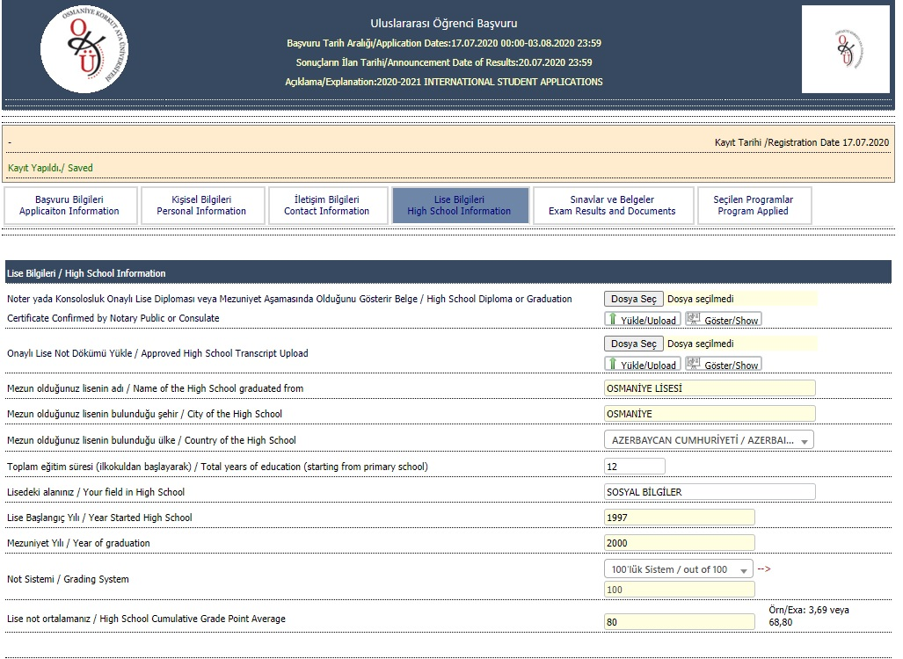
OKÜ ULUSLARARASI ÖĞRENCİ BAŞVURUSU
Please upload here the original high school diploma and its certified translation into Turkish.
Applicants need to fill in all the required areas
You can advance to the next page once you fill in all the required areas

Slide 12
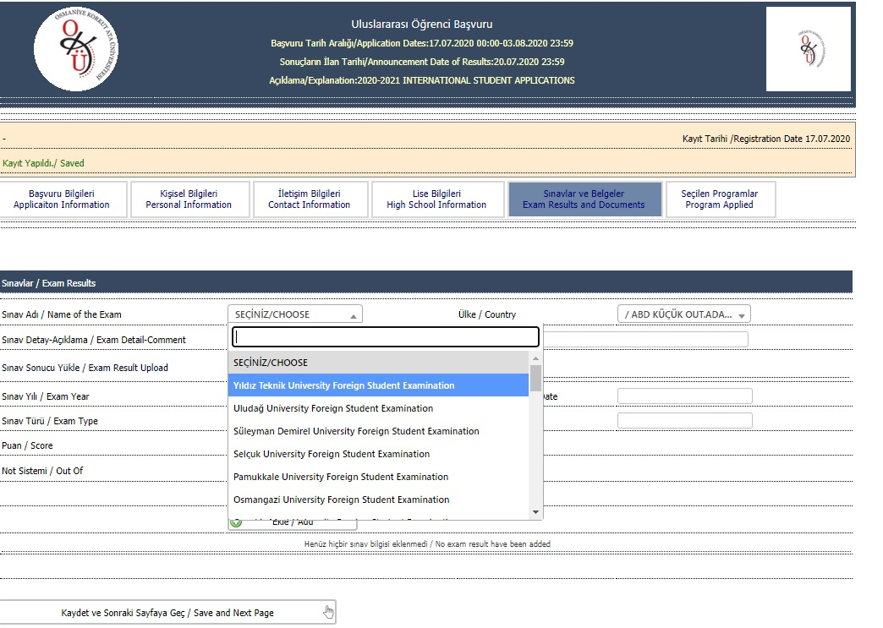
OKÜ ULUSLARARASI ÖĞRENCİ BAŞVURUSU
Exam and country selection

Slide 13
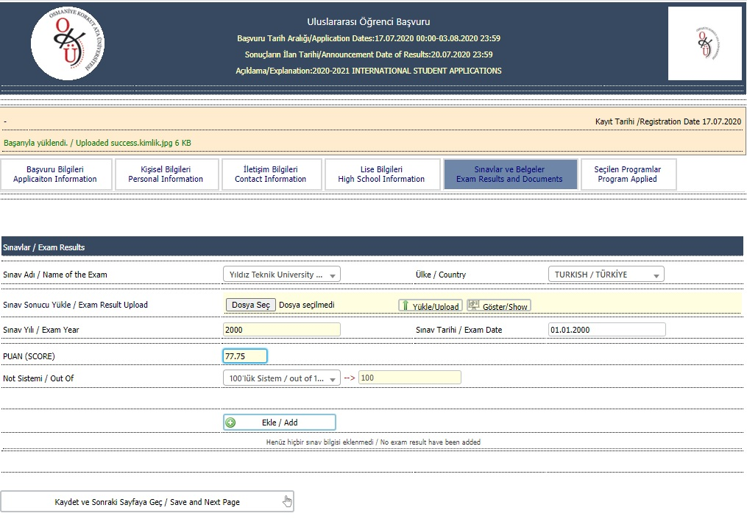
OKÜ ULUSLARARASI ÖĞRENCİ BAŞVURUSU
Please upload your exam result here.
All the required areas must be filled in. 0-100 scale must be selected as Grading system.
A valid exam result must be uploaded to the system using the button «add»
You can advance to the next page once you fill in all the required areas.

Slide 14
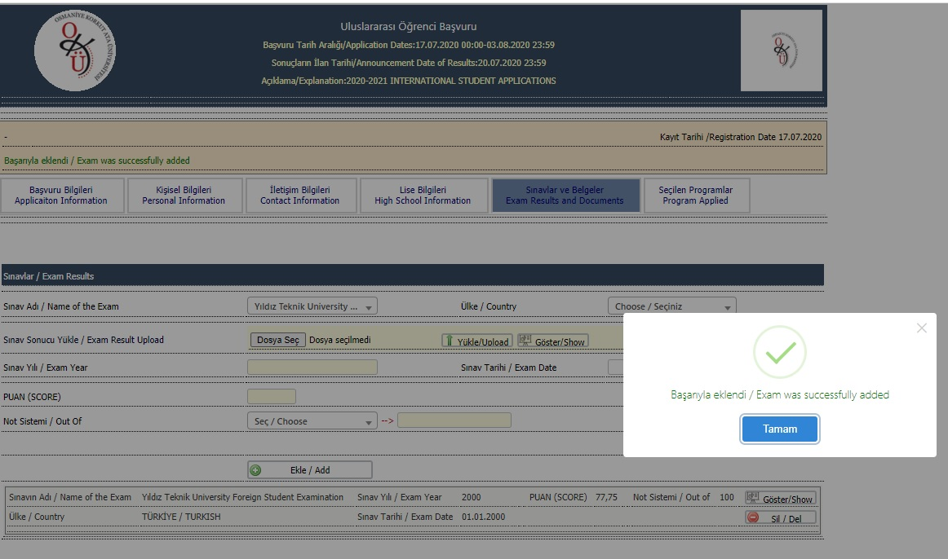
OKÜ ULUSLARARASI ÖĞRENCİ BAŞVURUSU
Click the button «Tamam» once you receive this file upload success notice. Go to the following page using the button «Kaydet/Save».

Slide 15
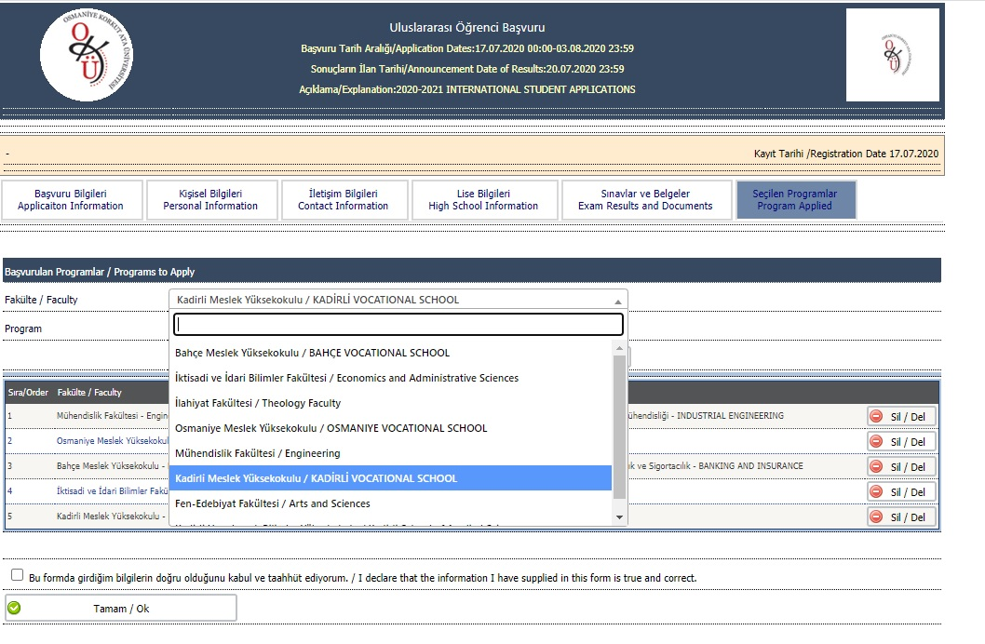
OKÜ ULUSLARARASI ÖĞRENCİ BAŞVURUSU
Select the programs that you wish to apply for. Please keep in mind that you are only allow to select up to 5 programs

Slide 16
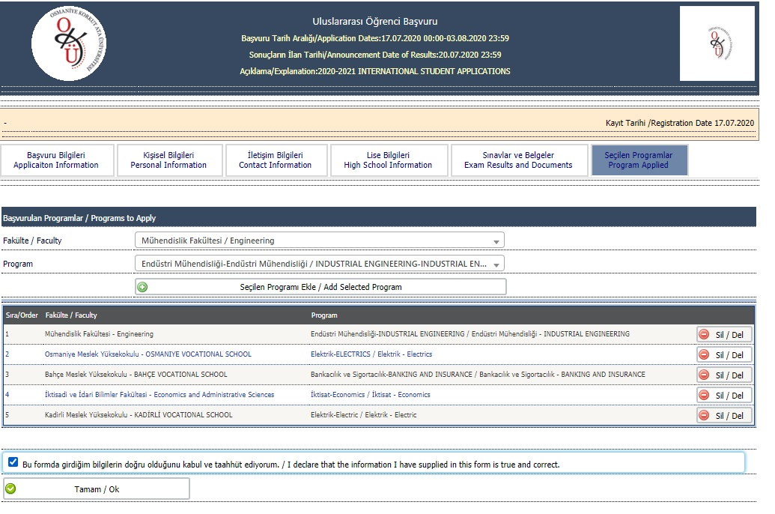
OKÜ ULUSLARARASI ÖĞRENCİ BAŞVURUSU
Selected programs need to be entered one by one using the button «Add selected program».

Slide 17
OKÜ ULUSLARARASI ÖĞRENCİ BAŞVURUSU
Tick the box to confirm that all the provided information is true and correct and, then, click the button «Tamam/OK» to complete the application

Slide 18
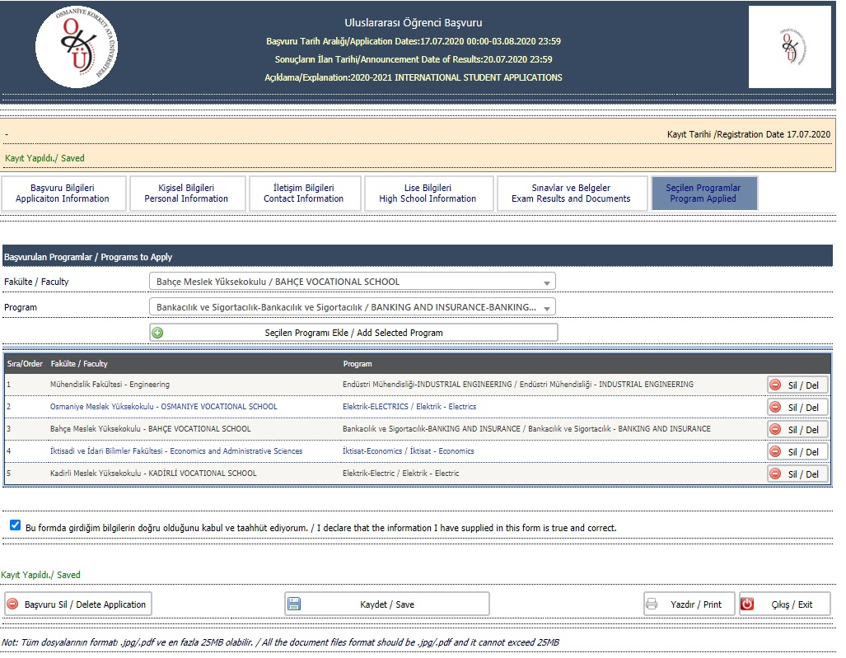
OKÜ ULUSLARARASI ÖĞRENCİ BAŞVURUSU
The notice displayed on the screen «Kayıt Yapıldı/Saved» means that the application is completed

Slide 19
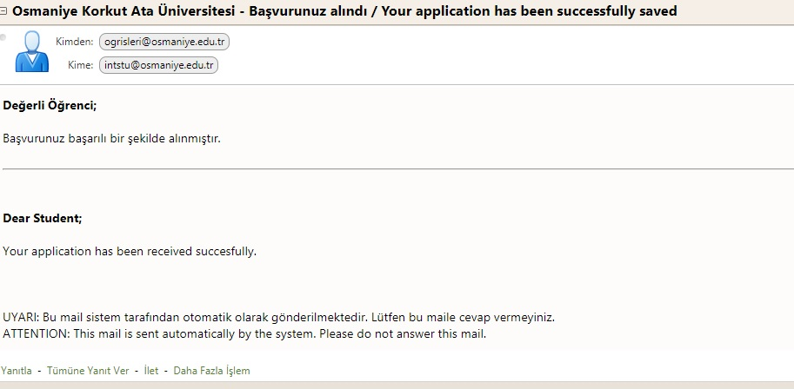
OKÜ ULUSLARARASI ÖĞRENCİ BAŞVURUSU
You will get an e-mail shortly confirming that your application has been received.

Slide 20
OKÜ ULUSLARARASI ÖĞRENCİ BAŞVURUSU
Dear Candidates,
Thank you for your interest in the Osmaniye Korkut Ata University. We’re proud that you have chosen us for these important next steps in your career. We look forward to having you as our students soon…

